Slide 1
BDD with Specflow
Binding business requirements to .NET code
Software Quality Assurance
Telerik Software Academy
http://academy.telerik.com

Slide 2

The Lecturer
Georgi Darakchiev
Principal QA Engineer
XAML Team3

Slide 3

Table of Contents
Test Driven Development
What is wrong with it
Useless Products Problem
Examples
Behaviors Driven Development
BDD Theory
BDD Tools
Specflow Demo

Slide 4
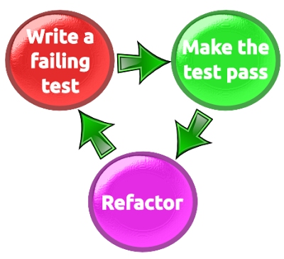
Test Driven Development
Usually TDD = Unit tests written from developer for his/her own code
Usually result in “confirmation that the system does what it does”

Slide 5

Bike Example
Let’s write some tests that test a bike
Verify pedals are available
Verify breaks are available
Verify seat is available
Verify bike has two tires

Slide 6
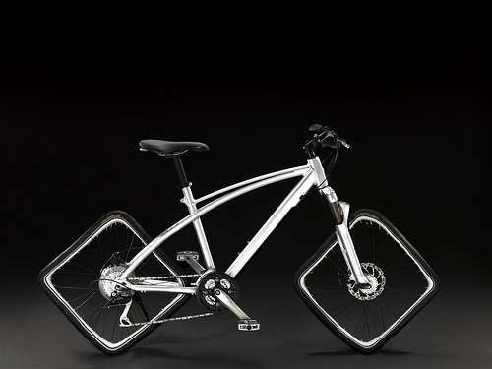
Bike Example
Is it a Bike?
Pedals
Breaks
Seat
Two Tires
It is a useless bike!

Slide 7
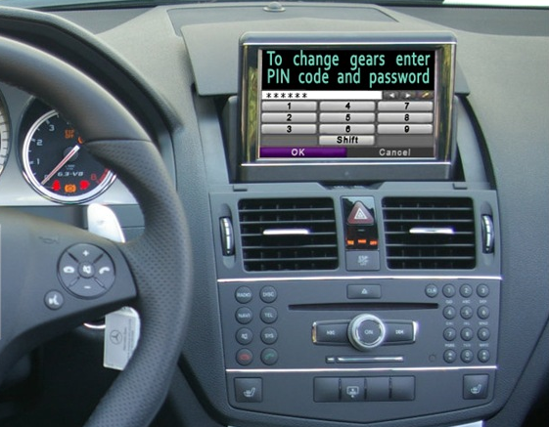
Useless Car Example

Slide 8

The Problem
What happened?
ITs are not Domain Experts
Domain Experts don’t know the technology

Slide 9
The Solution
How to solve the problem?
Make sure Acceptance Criteria is defined by Domain Experts
Make sure Domain Experts and ITs talk the same language
Make sure you have Single Source of Truth
Illustrate requirements using examples
Automate those examples

Slide 10

Behavior Specifications
Title (one line describing the story)
Narrative:
As a [role]
I want [feature]
So that [benefit]
Acceptance Criteria: (presented as Scenarios)
Scenario 1: Title
Given [context]
And [some more context]...
When [event]
Then [outcome]
And [another outcome]...
Scenario 2: ...

Slide 11
Scenario Example
Scenario: Divide by zero
Given clean calculator
When press 1
And press divide button
And press 0
And press equal button
Then the result should be
Cannot divide by zero

Slide 12
Bad Scenario Example
Scenario: Divide by zero
Given calculator.exe is started
When click button with id=Btn1
And click button with id=BtnDevide
And click button with id=Btn1
And click button with id=BtnEqual
Then text box with name=Result contains Cannot divide by zero text

Slide 13
How to Write Scenarios
Don't specify business rules...
...but key business examples
Customer can easily read and understand them
Features should only contain information that the user sees
Step description should never contain regexes, CSS or XPath selectors, any kind of code or data structure

Slide 14
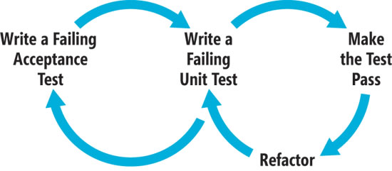
BDD Picture
Based on TDD
Focusses on behavior of the product

Slide 15
BDD Tools
BDD Tool | Specifications Format | Implements Gherkin | Platforms
Specflow | Plain text | Yes | .NET
Cucumber | Plain text | Yes | Ruby
Cucumber-JVM | Plain text | Yes | Java and JVM languages
Jbehave | Plain text | Yes | Java
Rspec | BDD like API | No | Ruby
Concordion | Html | No | Java, .NET, Python, Scala, Ruby

Slide 16
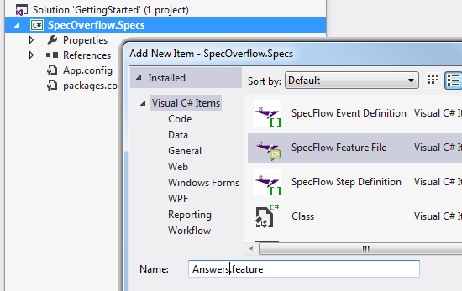
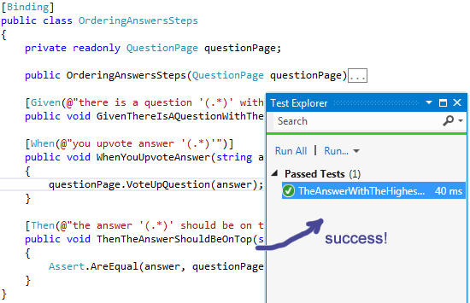
SpecFlow
DEMO
Notes:
Demos should be delivered in parallel with slides presentation.

Slide 17
Specflow
?
?
?
?
?
Questions?
?
?
?
?
?
?

Slide 18
Exercise
Using specflow create test that:
Navigates to http://demos.telerik.com/aspnet-mvc/combobox/index
Select a item from one of the ComboBoxes
Assert the item is selected
Modify the existing test using Scenario Outline in order to run it in against 3 different browsers (this will create 3 different tests)

Slide 19




Free Trainings @ Telerik Academy
C# Programming @ Telerik Academy
csharpfundamentals.telerik.com
Telerik Software Academy
academy.telerik.com
Telerik Academy @ Facebook
facebook.com/TelerikAcademy
Telerik Software Academy Forums
forums.academy.telerik.com

